Slide 1
Hurricane Matthew Tweet Analysis
Team : 15
Ahmed Albishri
Akhila Katta
Khalid Almalki
Megha Nagabhushan

Slide 2
Introduction
Big data is an evolving term that describes any voluminous amount of structured, semi-structured and unstructured data that has the potential to be mined for information. But it’s not the amount of data that’s important.
Software’s used:
Scala IDE, Hadoop, Eclipse IDE for Scala, IntelliJ, D3.js, Java script, HTML, CSS, Google Maps API
Used Libraries :-
Twitter4J

Slide 3
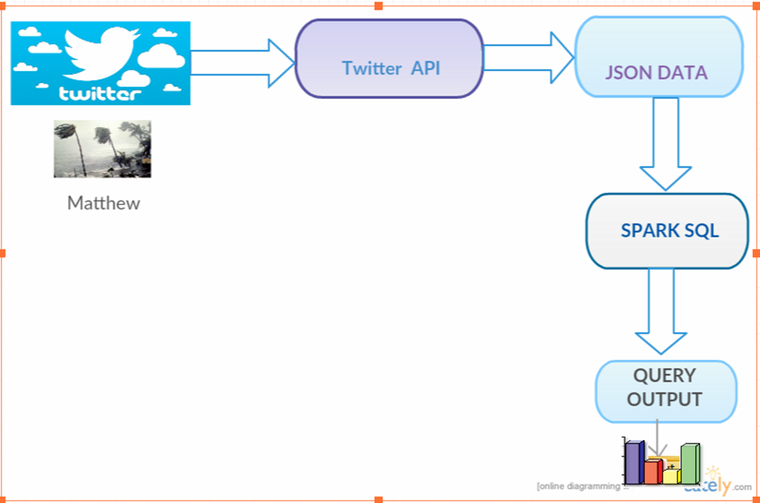
Project Theme and Implementation
Collected tweets from Twitter Streaming API with filter as “Matthew hurricane”.
Queried the collected data.
Created web interface which gets data and visualizes the output in interesting charts using different charting js libraries.

Slide 4
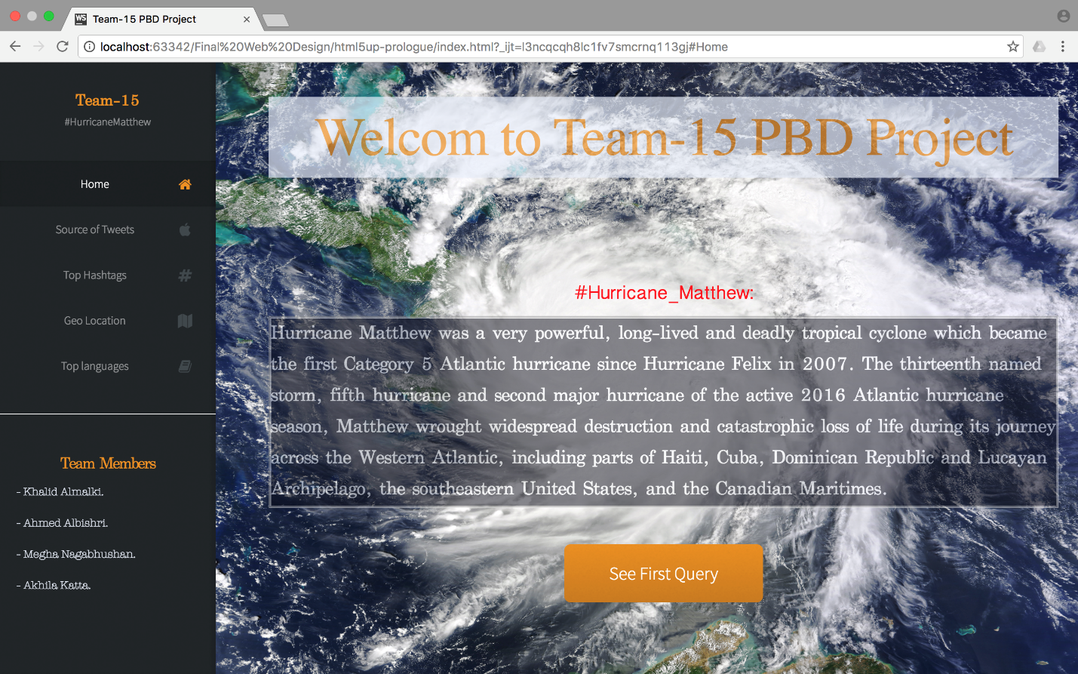
Visualization
Project Presentation Video Link : https://youtu.be/K3BzqW6YIi8

Slide 5
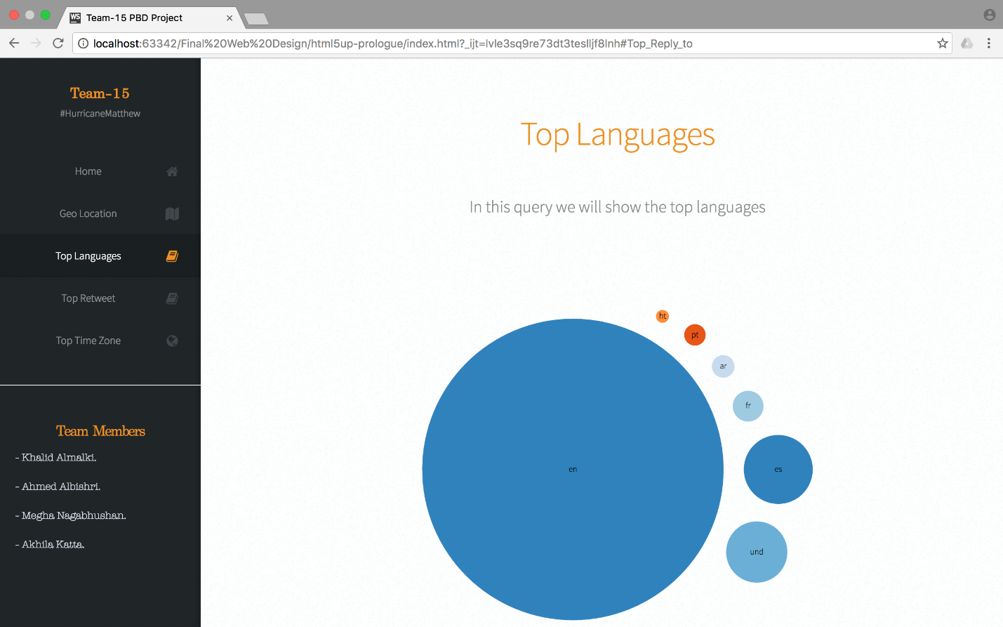
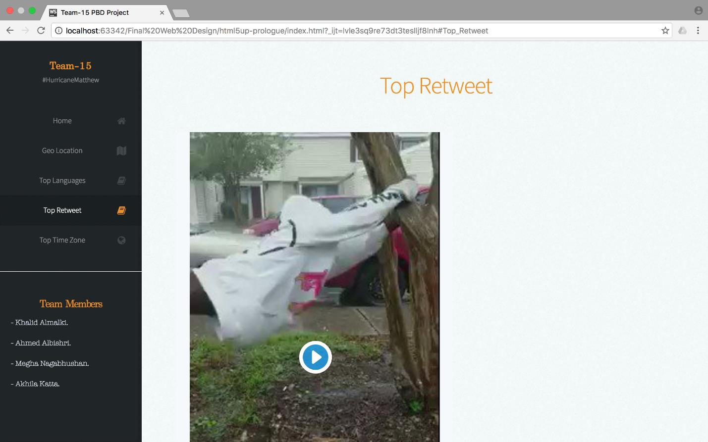
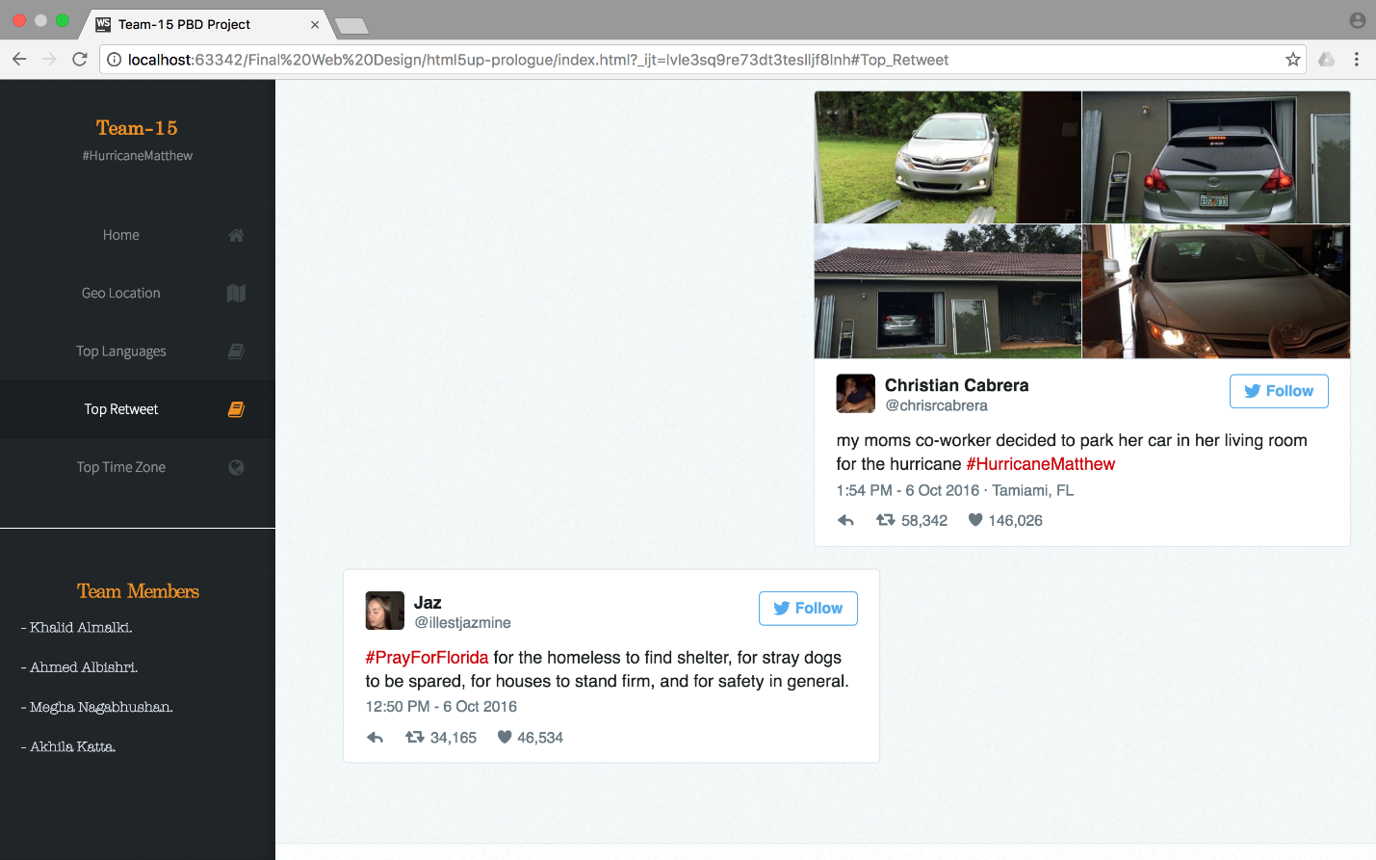
Visualization

Slide 6
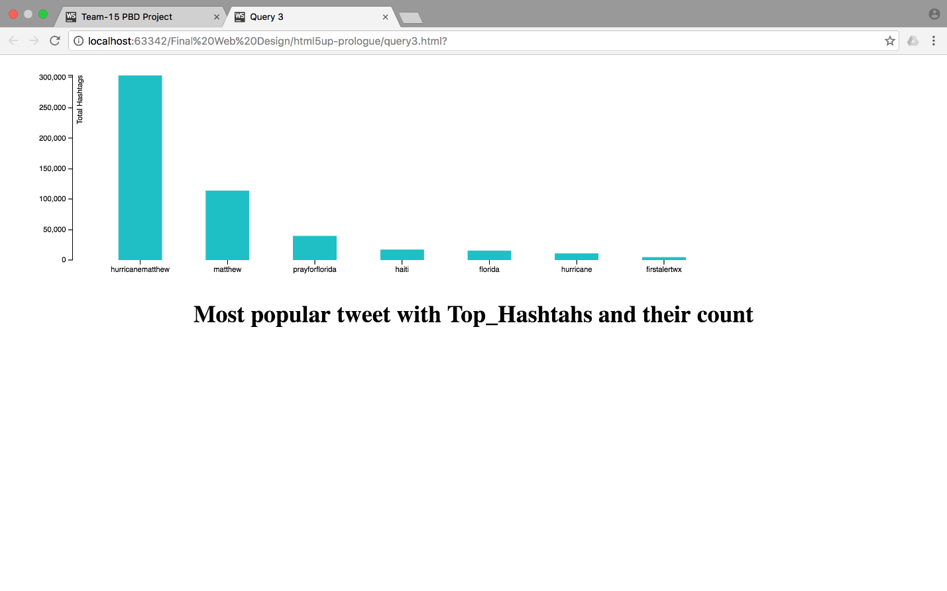
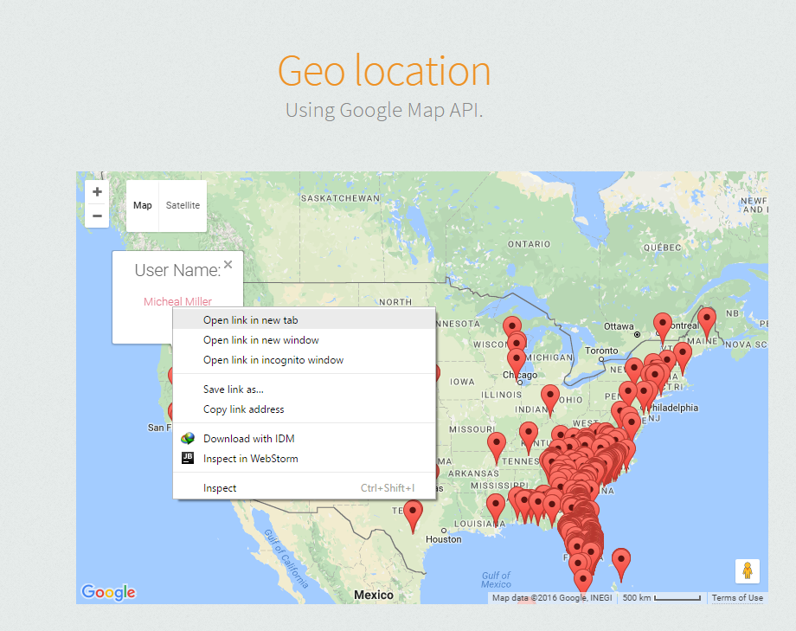
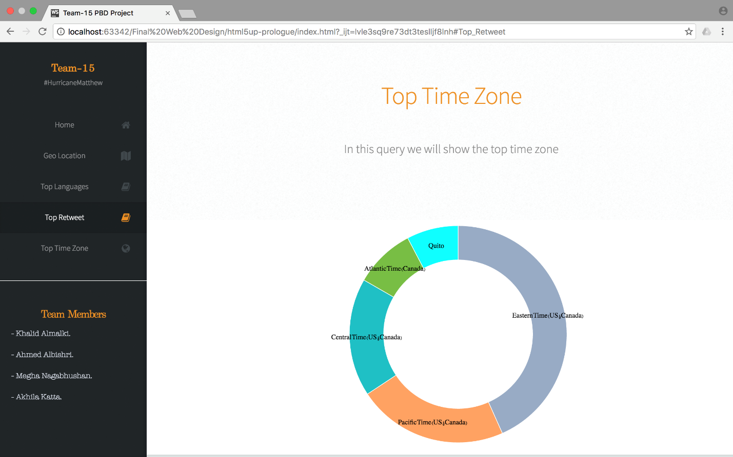
Visualization

Slide 7
Thank you!!

